Slide 1
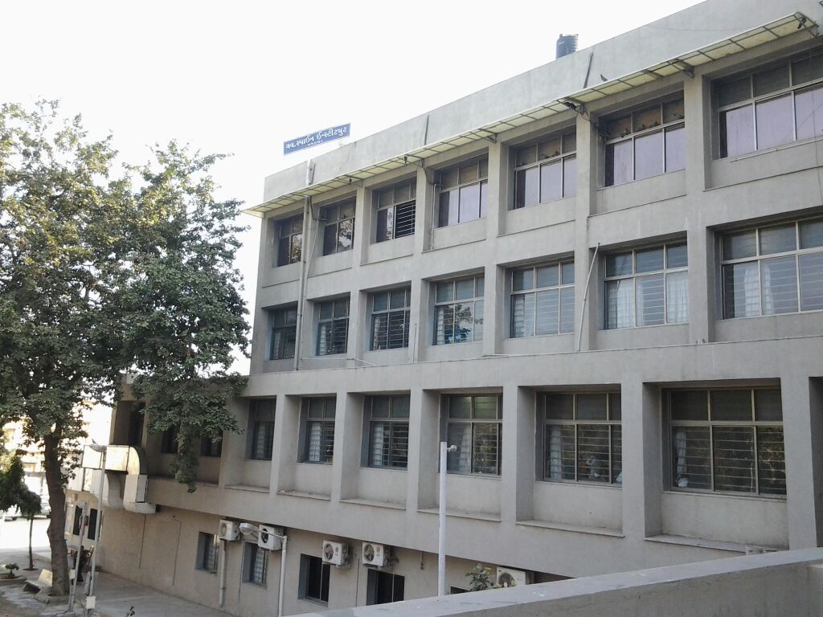

Government Spine Institute & Physiotherapy College
Quality Indicators
January to June 2021

Slide 2

1. (PSQ3a)Initial Assessment by Nurse
Formula -Sum of time taken for initial the assessment by Nurse /
Total number of admissions
Benchmark 60 Min

Slide 3
1. (PSQ3a)Initial Assessment by Doctor
Formula-Sum of time taken for initial assessment by Doctor /Total number of admissions
Benchmark 24 Hours

Slide 4
1. (PSQ3a) A Initial Assessment by MSW
Formula-Sum of time taken for initial assessment by MSW /Total number of admissions
Benchmark 24 Hours

Slide 5
1. (PSQ3a) Initial Assessment by Physiotherapist
Formula-Sum of time taken for initial assessment by Physiotherapist /Total number of admissions
Benchmark 24 Hours

Slide 6
1. (PSQ3a) Initial Assessment by Occupational therapist
Formula-Sum of time taken for initial assessment by Occupational therapist /Total number of admissions
Benchmark 24 Hours

Slide 7
1. (PSQ3a) Initial Assessment by Prosthetics & Orthotics
Formula-Sum of time taken for initial assessment by P & O /Total number of admissions
Benchmark 24 Hours

Slide 8
1. (PSQ3a) Initial Assessment by Dietician
Formula-Sum of time taken for initial assessment by Dietician /Total number of admissions
Benchmark 24 Hours

Slide 9
2. (PSQ3a) Number of Reporting Error /1000 investigations (Radiology)
Formula- Number of reporting errors/ Number of tests performed (Radiology)
Benchmark 0%

Slide 10
2. (PSQ3a) Number of Reporting Error /1000 investigations (Pathology)
Formula- Number of reporting errors/ Number of tests performed (Pathology)
Benchmark 0%

Slide 11
3. (PSQ3a) Percentage of adherence to safety precautions by employees working in diagnostics.( Radiology)
Formula- Number of employees adhering to safety precautions/Number of employees sampled (Radiology)
Benchmark 100%

Slide 12
3. (PSQ3a) Percentage of adherence to safety precautions by employees working in diagnostics (Pathology).
Formula- Number of employees adhering to safety precautions/Number of employees sampled(Pathology)
Benchmark 100%

Slide 13
4. (PSQ3a) Incidence of medication errors- Prescription
Formula- a.Total Number of prescription errors/Total number of prescriptions reviewed
Benchmark 5%

Slide 14
5. (PSQ3a) Percentage of medication charts with error prone abbreviations
Formula- Number of medication charts with error prone abbreviations/Number of medication charts reviewed
Benchmark 0%

Slide 15
6. (PSQ3a) Percentage of in-patients developing adverse drug reaction
Formula- Number of patients developing adverse drug reaction/Number of in patients
Benchmark 0%

Slide 16
7. (PSQ3a) Percentage of unplanned return to OT
Formula- Number of unplanned return to OT/Number of patient operated
Benchmark 0%

Slide 17
8. (PSQ3a) Percentage of cases where the organization’s procedure to prevent adverse events like wrong site, wrong patient and wrong surgery have been adhered to
Formula- Number of case where the procedure was followed/Number of surgeries performed
Benchmark 100%

Slide 18
9. (PSQ3a) Percentage of transfusion reactions (1) Ward
Formula- Number of transfusion reactions/Number of units transfused
Benchmark 0%

Slide 19
9. (PSQ3a) Percentage of transfusion reactions (2) OT
Formula- Number of transfusion reactions/Number of units transfused
(O.T.)
Benchmark 0%

Slide 20
18. (PSQ3b) Percentage of cases who received appropriate prophylactic antibiotics within the specified timeframe
Percentage of cases who received appropriate prophylactic antibiotics/ Number of surgeries undertaken
Benchmark 100%

Slide 21
19. (PSQ3c) Percentage of re-scheduling of surgeries
Formula- Number of cases re-scheduled/Number of Surgeries planned
Benchmark 0%

Slide 22
20. (PSQ3c) Turnaround time for issue of blood and components – (i) Ward
Formula- Sum of time taken from order to receive / Total number of blood and blood components issued)
Benchmark 24 Hours

Slide 23
20 (PSQ3c) Turnaround time for issue of blood and components – (2) OT
Formula- Sum of time taken from order to receive / Total number of blood and blood components issued (O.T.)
Benchmark 30 Min

Slide 24
21. (PSQ3c) Nurse- Patient ratio for wards-1:6
Formula- Number of nursing staff/Number of beds To be calculated for each shift separately.
Benchmark 1.06

Slide 25
22. (PSQ3c) Waiting time for Out patient consultation
Formula- Sum of Patient- time for Consultation/Number of out patients
Benchmark 15 Min

Slide 26
23. (PSQ4c) Waiting time for including and Out patient consultation- (ii)diagnostics –X Ray
Formula- Sum total patient reporting time/ Number of patients reported in Diagnostics
Benchmark 15 Min

Slide 27
23. (PSQ4c) Waiting time for including and Out patient consultation- (ii)diagnostics –Laboratory
Formula- Sum total patient reporting time/ Number of patients reported in Diagnostics
Benchmark 15 Min

Slide 28
24. (PSQ4c) Time taken for discharge ( in Hours and min)
Formula- Sum of time taken discharge/Number of patients discharged
Benchmark 2 Hours

Slide 29
25(PSQ4c) Percentage of medical records having incomplete and/or improper consent
Percentage of medical records having incomplete and/or improper consent
Benchmark 0%

Slide 30
26. (PSQ4c) Percentage of stock outs of emergency medications
Formula- Number of stock outs of emergency drugs/Number of drugs listed as emergency drugs in hospital formulary X100
Benchmark 0%

Slide 31
27. (PSQ4d) Number of variation observed in mock drills
Formula- number of variations observed in a mock drill
Benchmark 0%

Slide 32
28. (PSQ4d) Patient fall rate (Falls per 1000 patient days)
Formula- Number of Patient falls /Total number of patients days X1000
Benchmark 0%

Slide 33
29. (PSQ4d) Percentage of near misses
Formula- Number of near misses reported /Number of incident reported
Benchmark 0%

Slide 34
31. (PSQ3d) Appropriate handovers during shift change (doctors) - (per patient per shift).
Formula- Total no of handovers done appropriately/Total no of handover opportunities
Benchmark 100%

Slide 35
31. (PSQ3d) Appropriate handovers during shift change (Nurses) - (per patient per shift).
Formula- Total no of handovers done appropriately/Total no of handover opportunities
Benchmark 100%

Slide 36
32. (PSQ3d) Compliance rate to medication Prescription in capitals
Formula- Total no of prescriptions in capital letters /Total no of prescriptions reviewed
Benchmark 100%

Slide 37
12. (PSQ3a) Incidence of hospital associated pressure ulcers after admission (Bed sore per 1000 patient days)
Formula- Number of patients who develop new/worsening of pressure ulcer/Total no of patient days X1000
Benchmark 0

Slide 38
13. (PSQ3b) Catheter associated Urinary tract infection Rate
Formula- Number of urinary catheter associated UTIs In a Month/Number of urinary catheter days in that month X1000
Benchmark 15

Slide 39
14. (PSQ3b) Central line associated bloodstream infection rate
Formula- Number of central line associated BSIs In a Month/Number of central line days in that month
Benchmark 0

Slide 40
16. (PSQ3b) Surgical site infection rate
Formula- Number of surgical site infections in a given month/Number of surgeries performed in that monthX100
Benchmark 5%

Slide 41
17. (PSQ3b) Compliance to Hand Hygiene practice
Formula- Total number of Hand hygiene actions performed/Total number of hand hygiene opportunities
Benchmark 0%

Slide 42
17. (PSQ3b) Compliance to Hand Hygiene practice- Doctors
Formula- Total number of Hand hygiene actions performed/Total number of hand hygiene opportunities
Benchmark 0%

Slide 43
17. (PSQ3b) Compliance to Hand Hygiene practice- Nurse
Formula- Total number of Hand hygiene actions performed/Total number of hand hygiene opportunities
Benchmark 0%

Slide 44
17. (PSQ3b) Compliance to Hand Hygiene practice- Paramedics
Formula- Total number of Hand hygiene actions performed/Total number of hand hygiene opportunities
Benchmark 0%

Slide 45
17. (PSQ3b) Compliance to Hand Hygiene practice- Housekeeping
Formula- Total number of Hand hygiene actions performed/Total number of hand hygiene opportunities
Benchmark 0%

Slide 46
16. (PSQ3a) Percentage of cases where the organization’s procedure to prevent adverse events like wrong site, wrong patient and wrong surgery have been adhered to
Formula- Number of case where the procedure was followed/Number of surgeries performed
Benchmark 100%

Slide 47
18. (PSQ3b) Percentage of cases who received appropriate prophylactic antibiotics within the specified timeframe
Formula-Number of patients who did receive appropriate prophylactic antibiotic(s)/Number of patients who underwent surgeries in the OT
Benchmark 100%

Slide 48
30. (PSQ3d) Incidence of needle stick injuries.
Formula- Number of parenteral exposures/Number of In patient days.X1000
Benchmark 0%

Slide 49
THANK YOU

